Slide 1
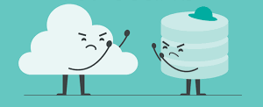
Remote vs Local Computing

Slide 2
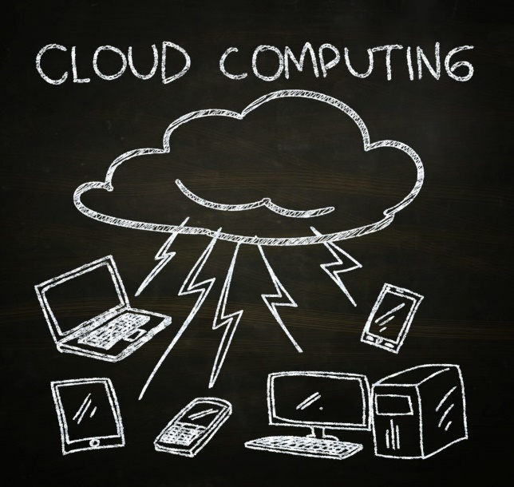
Remote or Cloud

Slide 3
Cloud Computing
Servers
  Computers that run all the time at a data center
  Shared resources like (CPU or cores, memory, storage)
  Have access larger memory, larger storage, etc.
Access is usually offsite
  SSH

Slide 4
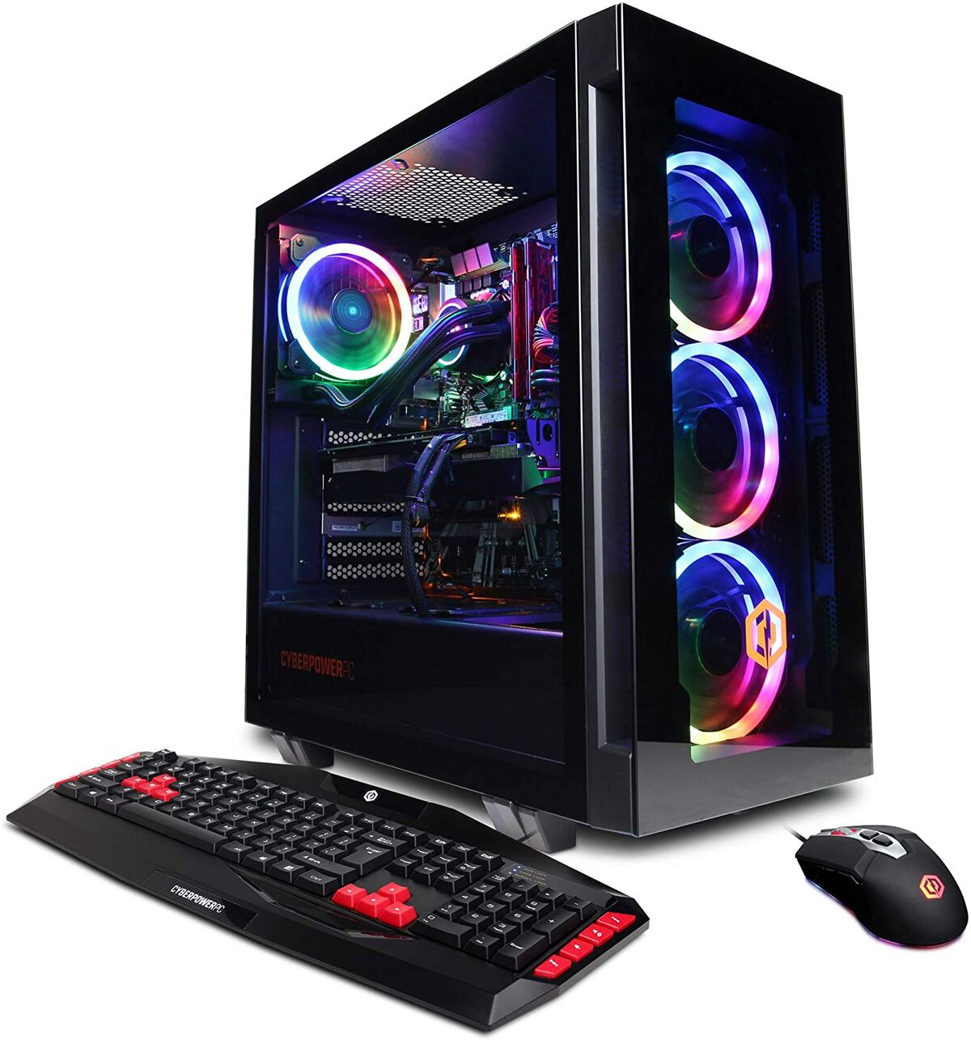
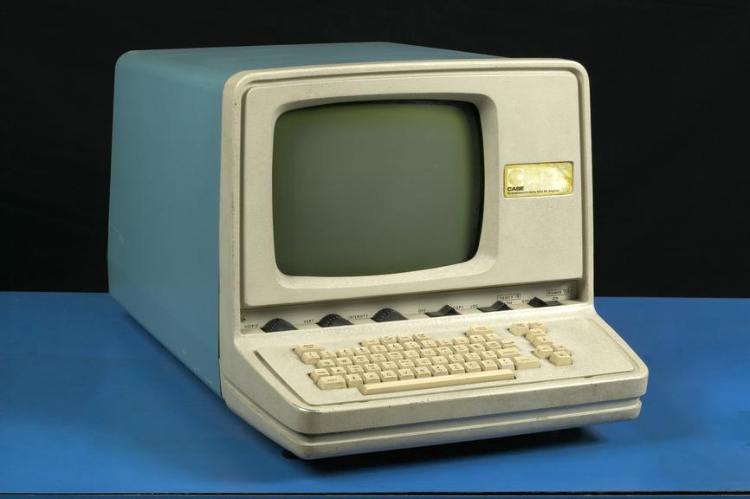
Local

Slide 5
Local Computing
Personal Device
  Computers storage, memory, peripherals vary
  Computing on time also varies
Access is usually onsite at the machine

Slide 6
Class Resources
GitHub.com
  Cloud
GitHub folder
  Local
PostgreSQL
  Spatialdb (Cloud)
PostgreSQL
  Localhost (local)

Slide 7

GitHub
Cloud
Clone (Pull)
Local
Add a File

Slide 8
GitHub
Cloud
Pull
Local
Add a File
Commit can be done on one or more files
Comment describing the changes made

Slide 9
GitHub
Cloud
Pull
Push
Local
Add a File
Commit can be done on one or more files
Comment describing the changes made

Slide 10
GitHub Reality
File management is really important.
GitHub can make multiple copies of the same local repository. Those copies can get out of sync
Do’s and Don’ts of commit/push
  Commit/push often because version control allows you to go back in time
  Descriptive comments are helpful

Slide 11
PostgreSQL
Cloud Sever
  Classroom database
    Students have limited privileges
  Personal database
    Each student as full access to their database
    Other students can view and sometimes query your DB.
      Can’t create or delete data on another DB
Local PostgreSQL
  Your personal database to do whatever you want. Its local to that computer, but can be helpful for initial tests of loading data or other things.

